Slide 1



PoshuPakhi

Slide 2

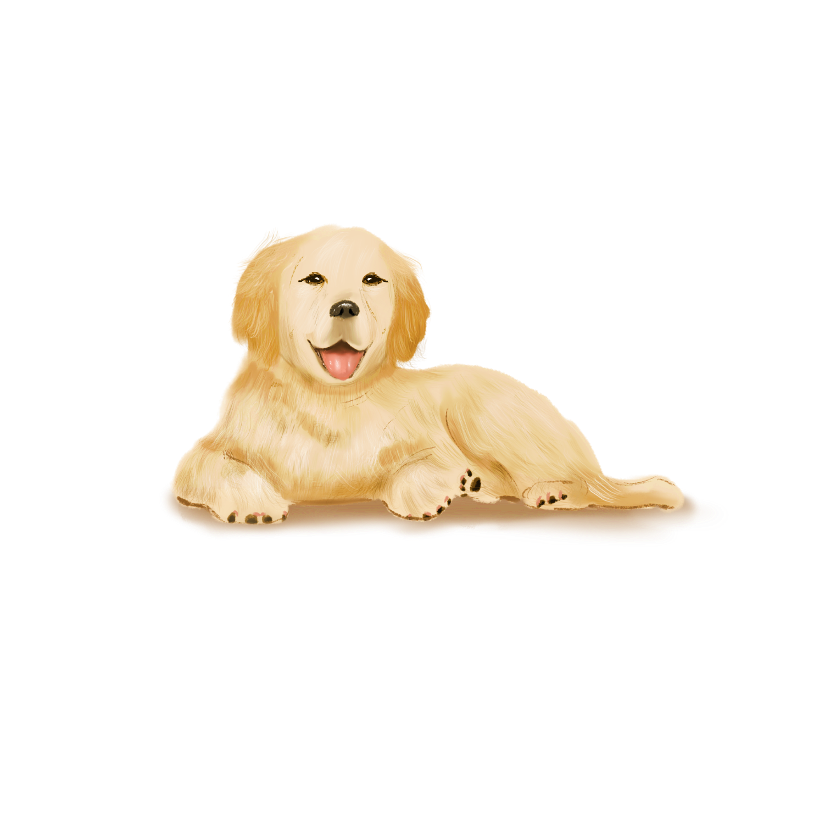
Directory/contents
01
Sheikh Sarafat Hosssin
2022-3-60-109
02
Rijia Parveen Raya
2022-3-60-192
03
Nipa Mridha
2022-3-60-254
04
Jubaiya Akter Shibly
2022-3-60-255

Slide 3

Introduction
PoshuPakhi is an online pet store that offers a wide range of products including pet food, grooming supplies, toys, and accessories. Customers can freely browse products without logging in and only need to register or log in when they decide to make a purchase. The platform supports a complete shopping experience — from filtering products and viewing detailed descriptions to secure checkout, order tracking, and customer support. On the backend, admins manage inventory, suppliers, orders, and delivery tracking through a powerful dashboard.

Slide 4
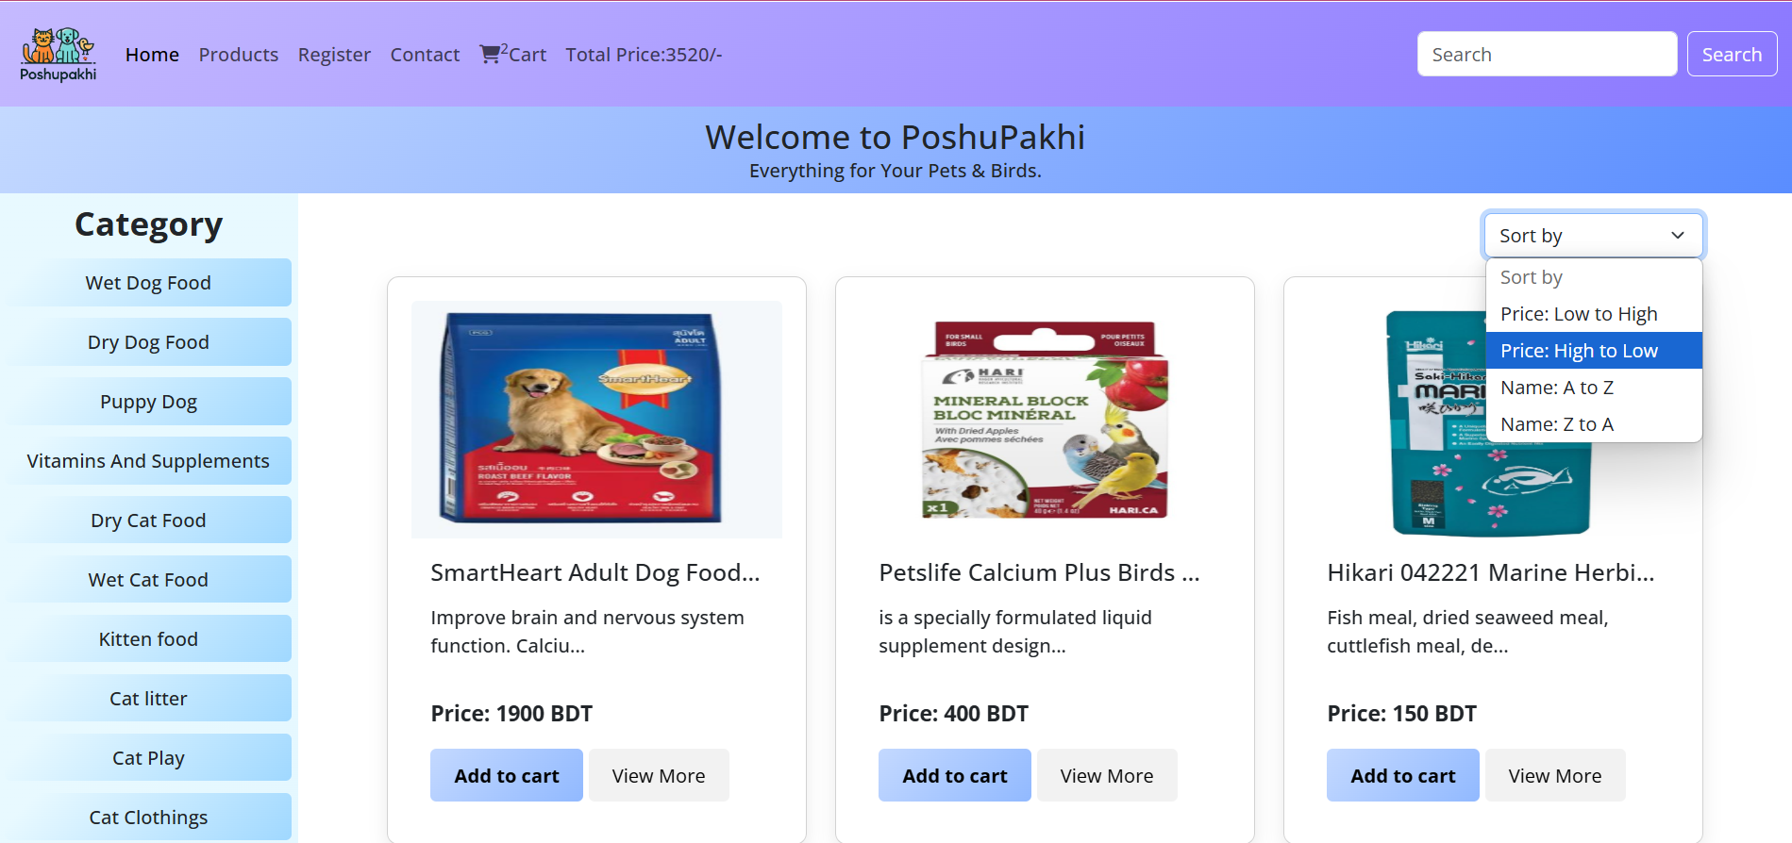

Slide 5
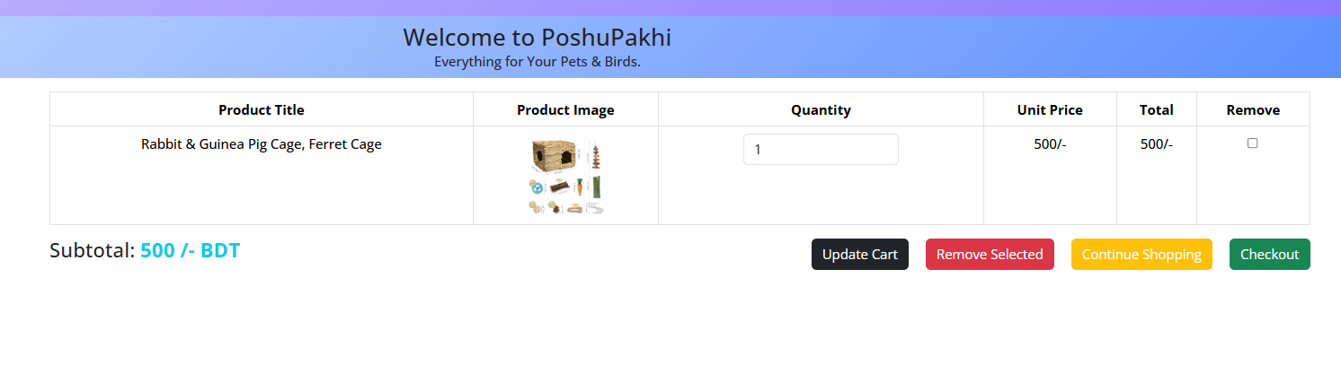
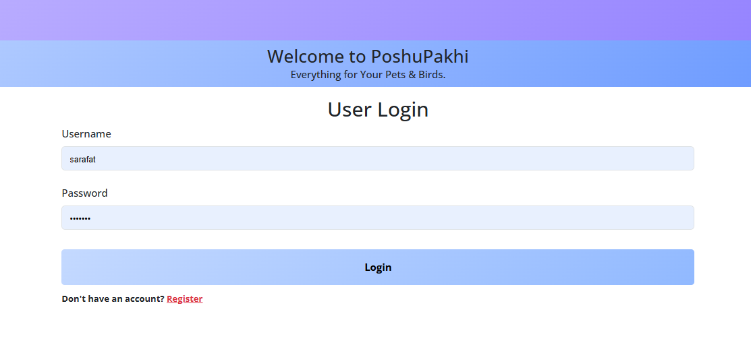

Slide 6
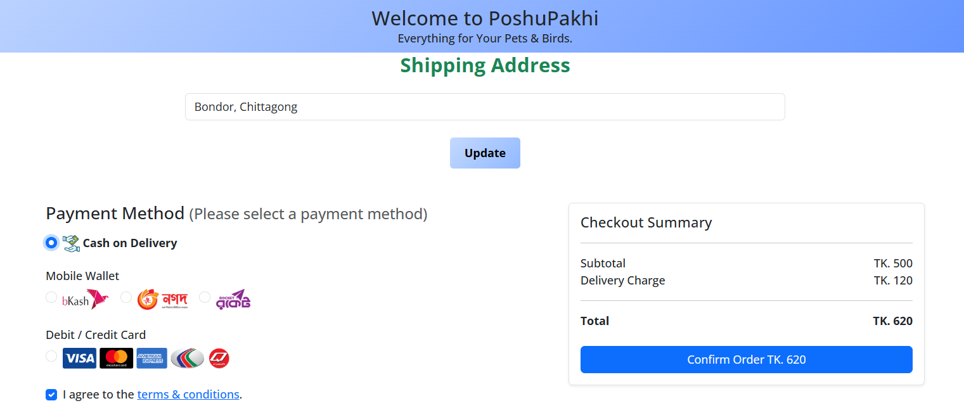

Slide 7
Objective of System Analysis in Online Business
System analysis helps e-commerce platforms like PoshuPakhi work smoothly by understanding what users need and making sure all parts of the system work well together. It ensures easy shopping for customers and smooth handling of orders, payments, and inventory.

Slide 8
Main Goals
Explain how PoshuPakhi functions from both customer and admin perspectives.
Demonstrate system structure and behavior using key analysis tools:
Use Case Diagram
Class Diagram
Data Flow Diagram (DFD)
Component Diagram
Deployment Diagram
Entity-Relationship (ER) Diagram
Activity Diagram
Highlight how system analysis ensures efficient design, smooth workflows, and enhanced user satisfaction in e-commerce.
Click here to
Click here to change text Click here to change text Click here to change

Slide 9
1. Use Case Diagram
Identifies system actors – such as customers, admins, and staff.
Displays core system functions – like browsing products or managing orders.
Maps interactions between users and the system – clarifying who does what.
Text content
Text content
01
Text content
01
02
01
02
02
03
03
03

Slide 10
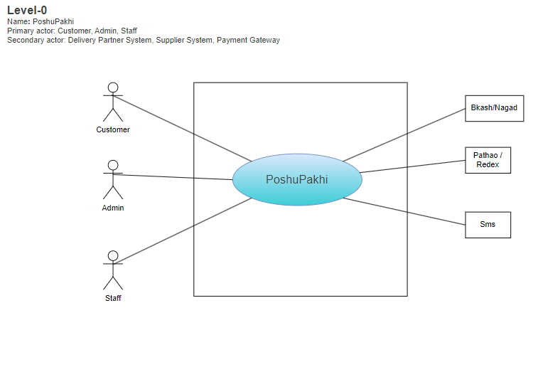
Use Case Diagram

Slide 11
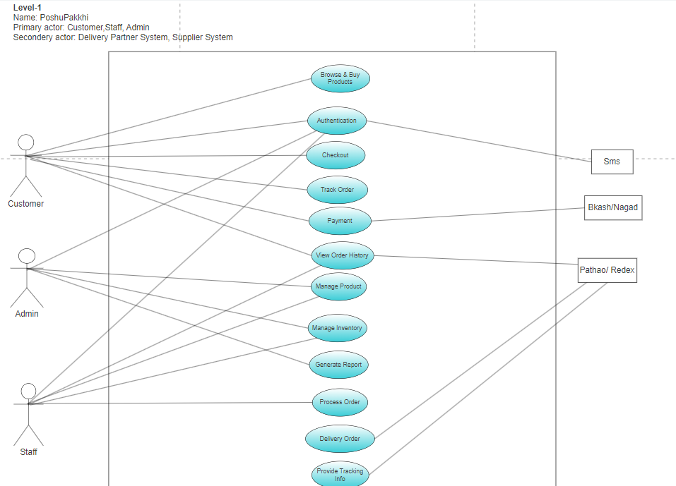
Use Case Diagram

Slide 12
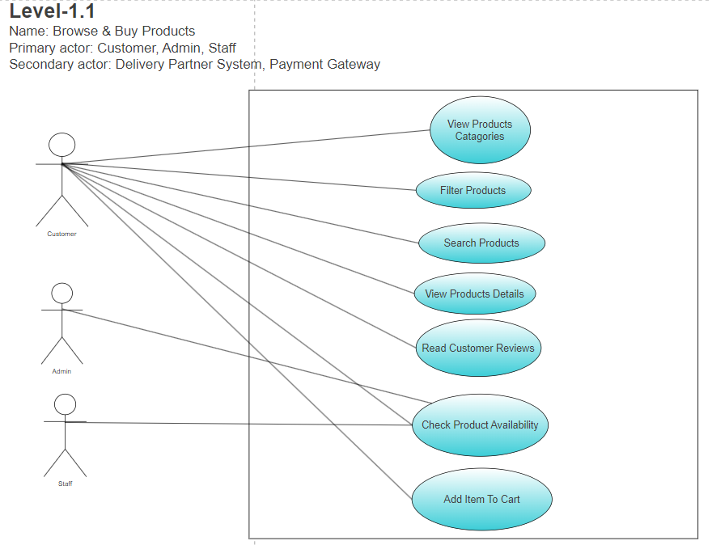
Use Case Diagram

Slide 13
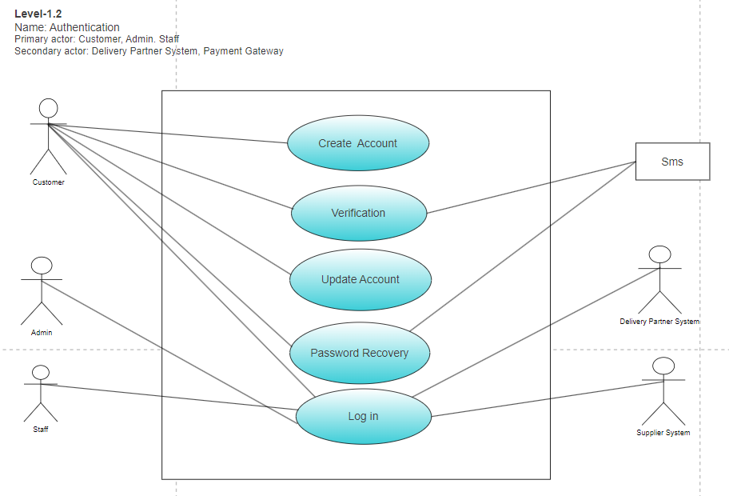
Use Case Diagram

Slide 14
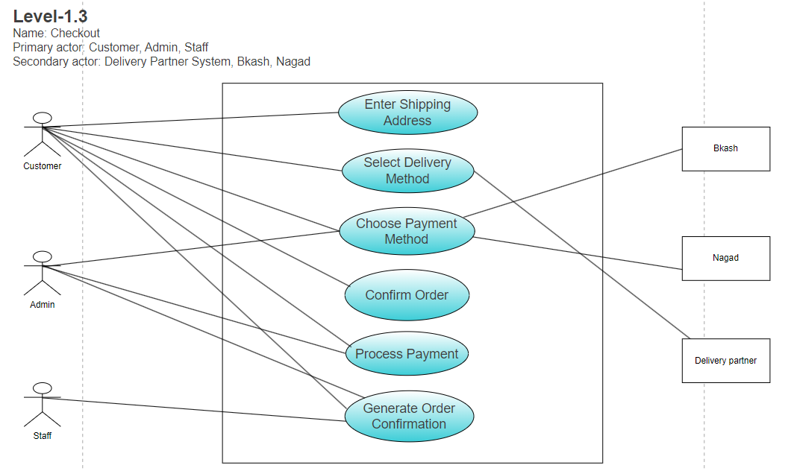
Use Case Diagram

Slide 15
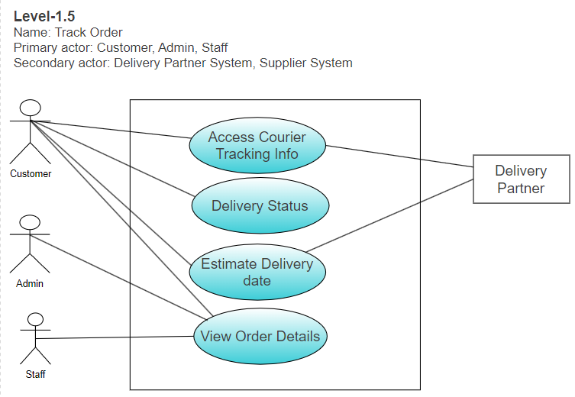
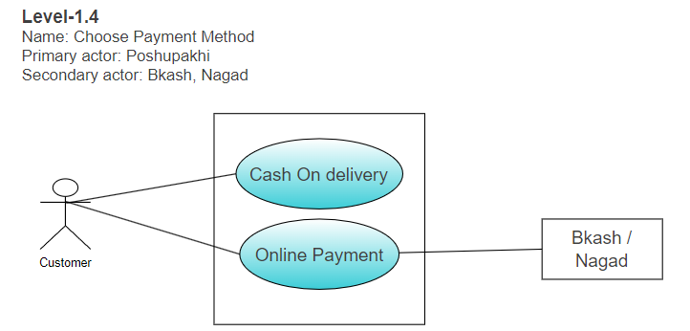
Use Case Diagram

Slide 16
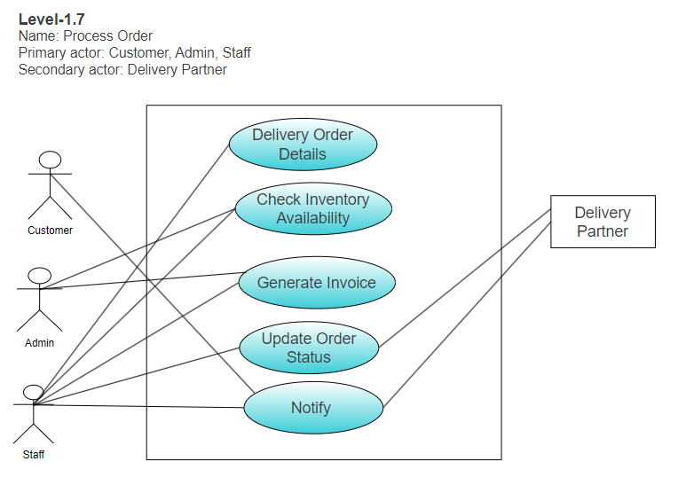
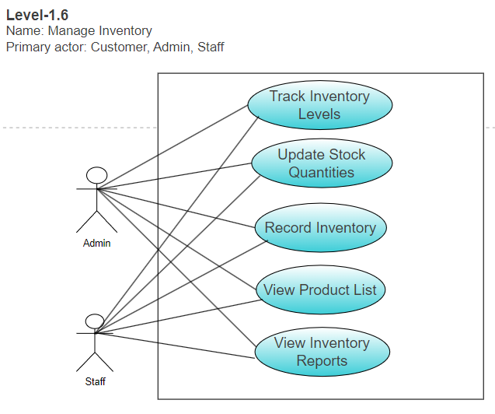
Use Case Diagram

Slide 17
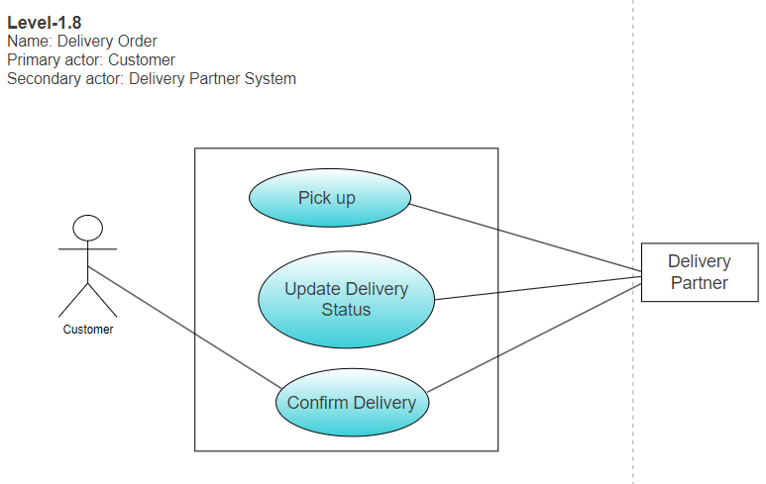
Use Case Diagram

Slide 18

Data Flow Diagram
Shows how data moves through the system between processes, data stores, and users.
.

Slide 19
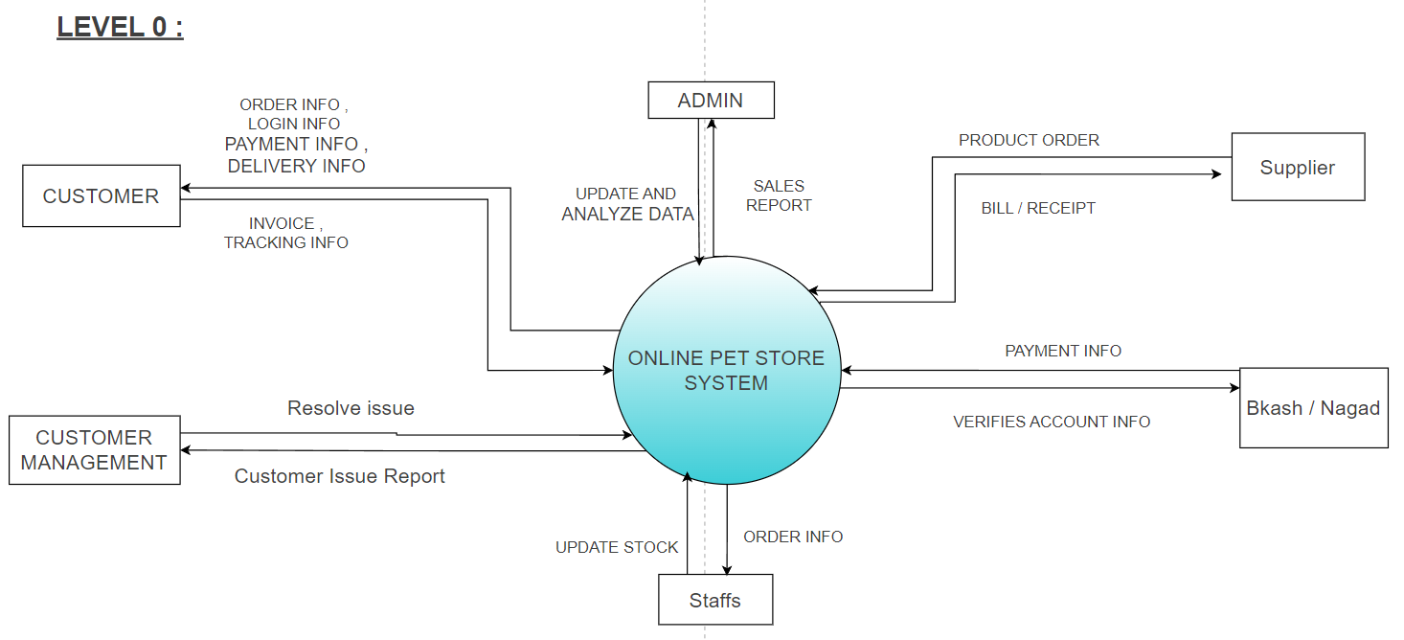
Data Flow Diagram

Slide 20
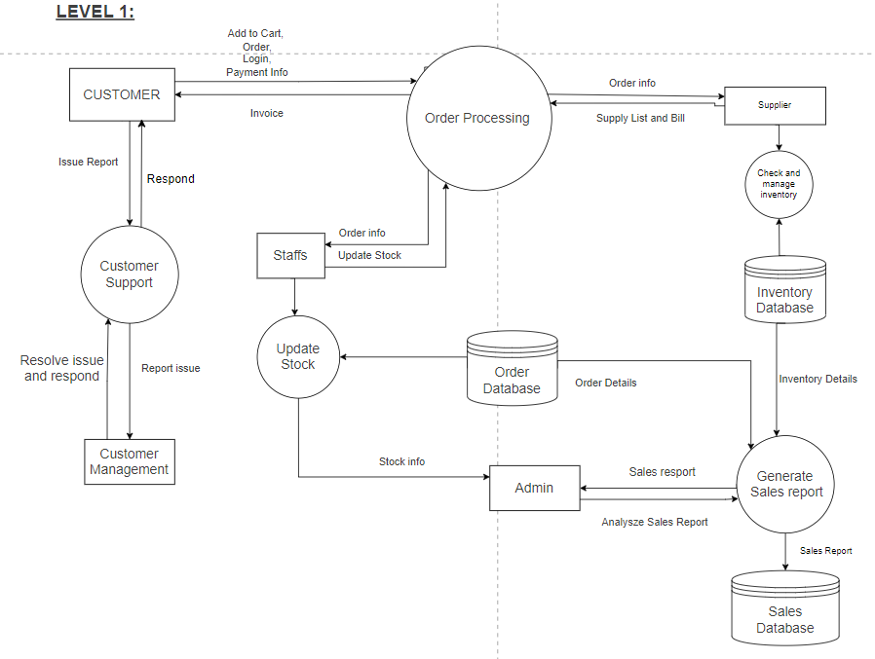
Data Flow Diagram

Slide 21
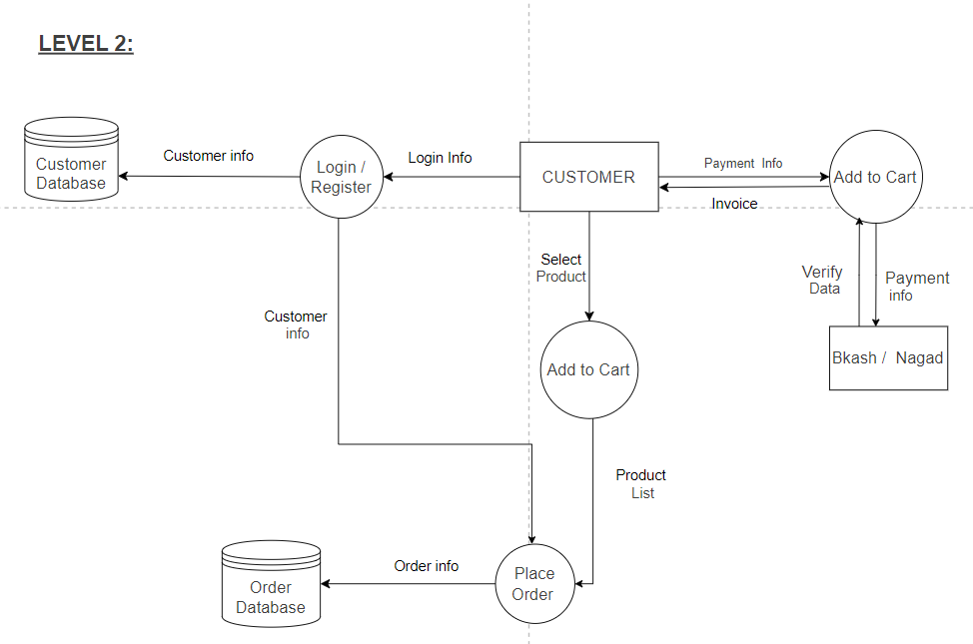
Data Flow Diagram

Slide 22


Class Diagram
Illustrates the system’s structure by showing classes, their attributes, methods, and relationships between them.

Slide 23
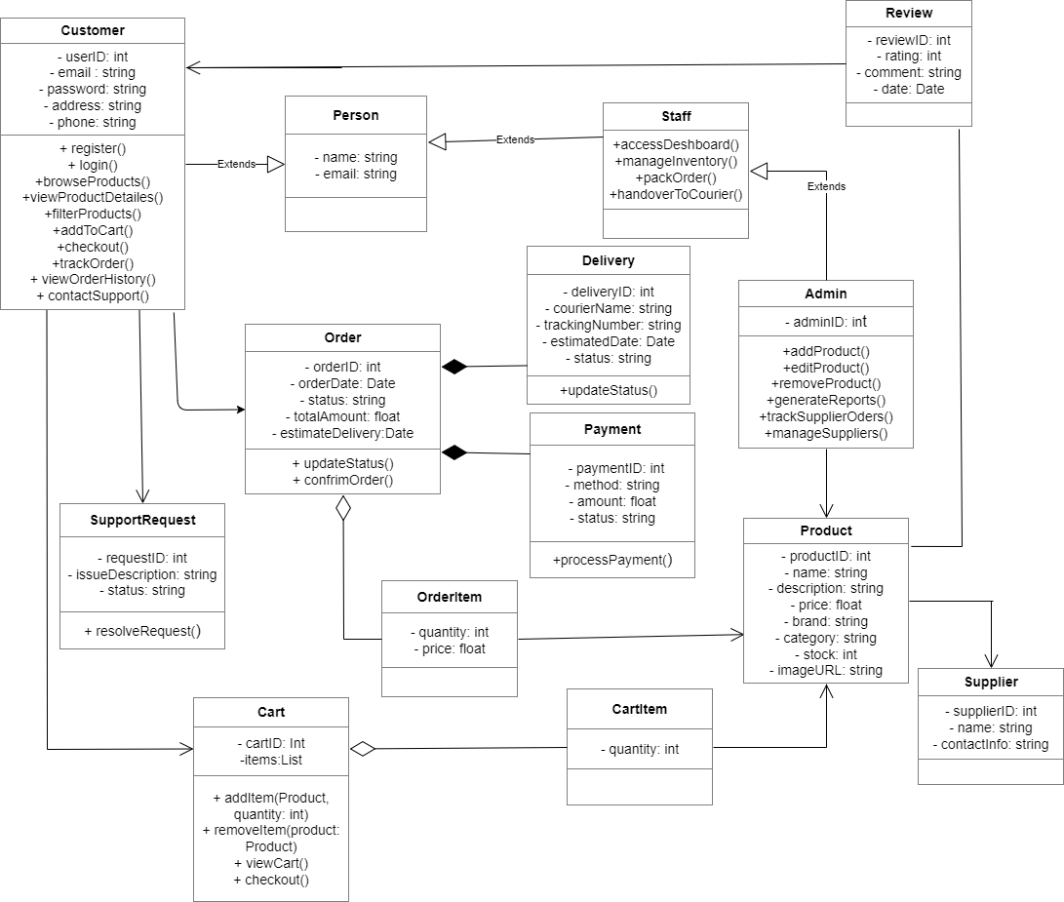

Slide 24


Component Diagram
Displays dependencies and interfaces between components
Visualizes the software architecture and interactions
Shows system components and their structure

Slide 25

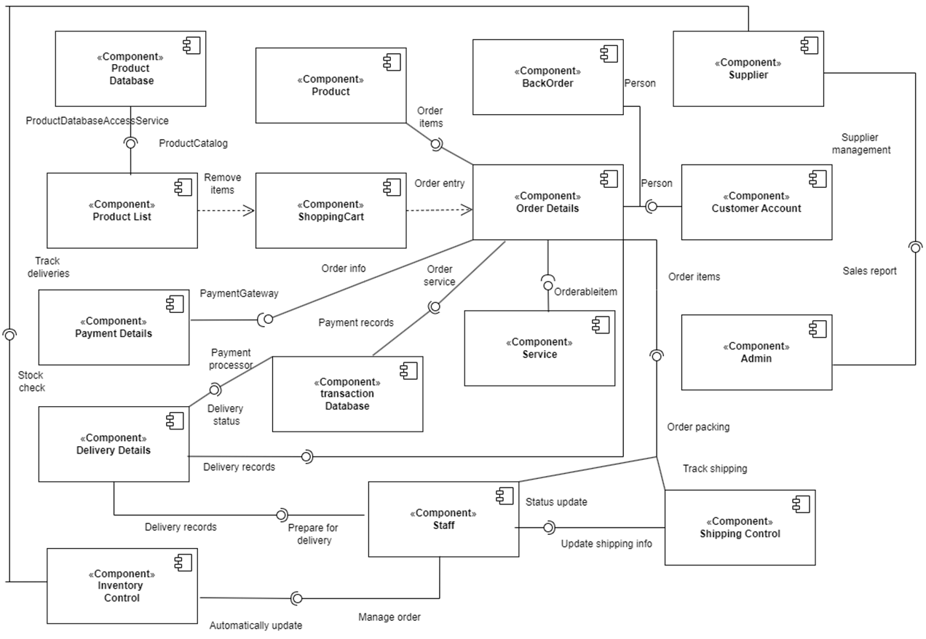
Component Diagram

Slide 26

Conclusion
The system analysis of the PoshuPakhi online pet store highlights how structured planning and modeling ensure smooth operations, efficient data flow, and enhanced user experience. Through the use of diagrams like Use Case, Class, DFD, and Component Diagrams, we clearly defined user interactions, system architecture, and data processes. This analysis not only supports better system design but also lays the foundation for scalability, reliability, and future improvements in e-commerce platforms.

Slide 27
Thank you

